Slide 1





Beaconfields Newsletter
Friday 15th November 2024
Be More Beaconfields
This week both Reception and Nursery class have enjoyed celebrating World Nursery Rhyme week. We have joined in singing and various activities for the following rhymes:
Twinkle Twinkle,
Old McDonald Had A Farm,
The Big Ship Sails,
Incy Wincy Spider
5 Currant Buns.
Nursery rhymes are so important and help with listening skills, vocabulary and language development. It would be lovely for the children to continue practicing them and share the rhymes at home with you this weekend.
Nursery class have also been on their first trip out to experience Forest School at one of our Trust schools, Parkside Primary School. They went on the minibus, put on their wellies and had some great fun exploring
in the forest.
We look forward to seeing you all next
week for another busy week.
Mrs Harratt

Slide 2



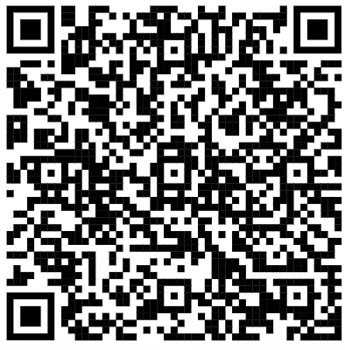
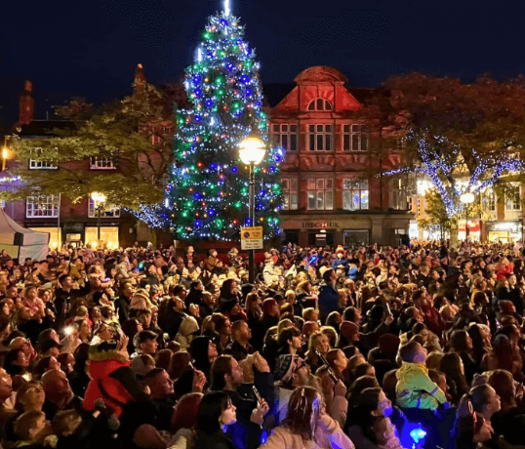



Reception intake application:
The application process for a Reception place for September 2025 is open. The link is now live and you can apply by using the QR code below.
The closing date is 15th January. You must apply even if you have an elder child already attending Beaconfields Primary School
Attendance
This week our Reception children
have achieved 96.43% attendance. We
aim to be above 97% every week.
REMINDER: School gates are open from 8:45-8:55AM
School ends at 3:25PM. Gates open at 3.20PM and will close at 3.30PM.
Please drop off and collect your child on time.
Stafford Christmas lights
Saturday 16th Nov
5pm turn on of the
Christmas lights.
Activities in the main high street start at 3pm.
Beaconfields Open day
Sunday 17th November
1 – 2:30pm
Our final open day is this Sunday at 1pm – 2:30pm
Please come along and see our fabulous new school.
Letter to Santa
It’s nearly Christmas, and we know you want to make sure that your letter to Santa Claus gets to him. Royal Mail are providing a free letter from Santa if you send your detail on a stamped envelope.
Get writing your letters as he needs them by the 9th December.

Slide 3


Dates for your diary
Forest Tots, 19th November 2024
Parkside Primary School are offering a free Forest School session to all toddlers within the local community. Please contact Parkside on 01785 450145 should you wish to join in on the fun.
Reception : Height and weights check
3rd December – in school
All information has been sent via email to parents
Reception : 4th December 2024 – Flu Vaccination
Please see email sent 15/11/24 for full detail on how to consent / not consent to your child being vaccinated.
Christmas Celebrations
Christmas Craft
Nursery class – Wednesday 4th December 9 am
Reception class – Friday 6th December 2:15pm
Wednesday 11th December 8am – 8:45am
Breakfast with Santa
Reception and Nursery Christmas Play
Thursday 12th December – 9:30am
Friday 13th December 2:00pm
Reception Class 17th December – ‘Aladdin’ Pantomime at Parkside Primary School
20th December – Christmas jumper/accessories day
Information for the above will be shared closer to the time
INSET day – 6th January Return to school 7th January 2025

