Slide 1





Beaconfields Newsletter
Friday 25th October 2024
Be More Beaconfields
We welcomed our Nursery parents to a ‘stay and learn’ session on Monday. They had great fun decorating pumpkins together, sharing a story and decorating biscuits with their children.
Reception have been learning about Diwali this week. They made Diva lamps and have learnt about 2d shapes when making Rangoli patterns..
We want to take this opportunity to celebrate our Beaconfields children. They have had a great first half term, learning the routines and expectations of our school and enjoying their learning.
Wishing you all a safe and restful half term and we will see you back on Tuesday 5th November to continue our Beaconfield's journey.
Mrs Harratt

Slide 2





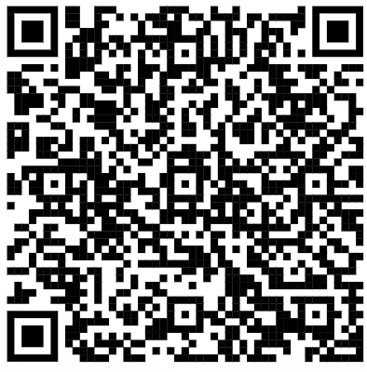

Friday 15th November
Children in Need
Children are invited to come to school dressed in spots and/or yellow. This may be accessories, tops or a full spotty/yellow outfit for the donation of £1.
All donations will go to
Children in Need.
Attendance
This week our Reception children
have achieved 96.07% attendance.
Reminder: please arrive on time to school each morning. Gate opens at 8.45am and closes at 8.55AM.
Parent Consultation Meetings
Thank you to all of those who attended the parent consultation sessions. Staff will be in touch to make an appointment if you were unable to attend this week.
Reception intake application:
The application process for a Reception place for September 2025 will open on 1st November 2024. The link will go live on the 1st November, and you can apply by using the QR code below.
The closing date is 15th January. You must apply even if you have an elder child already attending Beaconfields Primary School
.
Upcoming Dates:
Monday 4th November – INSET day
Wednesday 6th November 9AM – deadline to return photograph orders to school.
Friday 15th November - Children in Need
Sunday 17th November 1pm – 2:30pm Open Event
Tuesday 19th November - Forest Tots @ Parkside Primary School

