Slide 1





Beaconfields Newsletter
Friday 11th October 2024
Be More Beaconfields
Our Nursery children have been busy baking this week, they have enjoyed learning about nocturnal animals and were particularly interested in hedgehogs. The children have been learning about 'mixing' by mixing colours, ingredients and materials. They particularly enjoyed the skill of mixing when making their bread.
Reception have enjoyed learning about Autumn and Harvest time this week. They have been busy learning a song for their Harvest showcase next week and have enjoyed reading a story related to Autumn and have predicted who keeps stealing the leaves!
Have a lovely weekend, we look forward to seeing you on Monday.
Mrs Bell

Slide 2






The annual survey for the Families Health and Wellbeing (0-19) service is now live. Aimed at families with children and young people who have used the service in the last year to share their views on the service. .
The survey will run until 25th October 2024.
https://letstalk.staffordshire.gov.uk/embeds/projects/34142/survey-tools/37527
Attendance
This week our Reception children
have achieved 95.6% attendance.
Another great week with children
arriving to school on time and ready
for the day ahead.
Food Bank
Thank you for the donations received so far for our Beaconfields food bank.
We would welcome any further donations to keep us well stocked.
Parent Consultation Evenings
21st and 22nd October 2024
We look forward to sharing information about how your child has settled and the progress that they are making in Reception and Nursery at Beaconfields.
Please access Arbor to book an appointment.
If you need any support in booking an appointment,
please do not hesitate to contact the
school office,

Slide 3


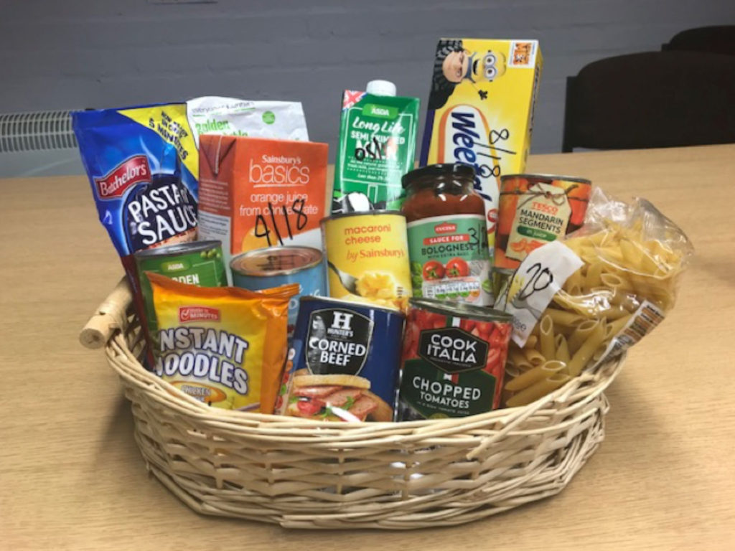
Open evening
Tuesday 15th October
5:30pm – 7pm
Come and look at our Reception class and nursery
Stay and Learn
Thank you to all who attended the Reception stay and learn session on Tuesday. This will be available every Tuesday morning for you to attend
Halloween Disco
25th October 3:25 – 4pm
Nursery and Reception children
Own clothes for the day but Halloween clothing/accessories can be added for the disco.
£1.50 will go to our brand new PTFA
Drinks and sweets will be provided to all children.
Booking information will be sent out next week
Reception Harvest Showcase
Friday 18th October 2:30pm in the school hall
Please can Reception children bring in a harvest donation by 17.10.24 (tins, pasta, crackers etc). All donations received will be added to our school food bank.

Slide 4


