Slide 1







WelcomeTo
Beaconfields Primary School
Be More Beaconfields

Slide 2



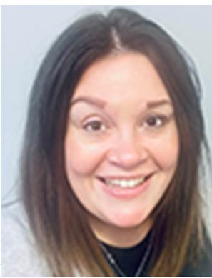
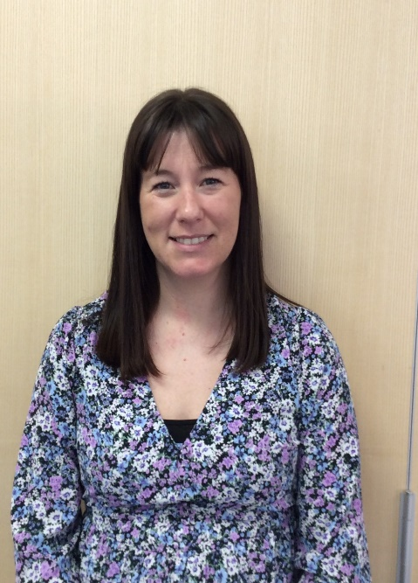
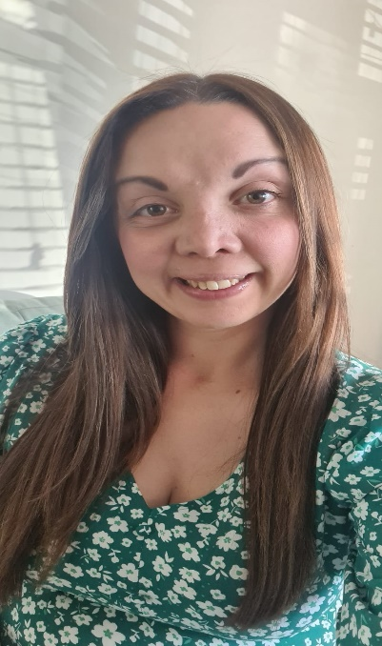
Meet the Team
.
Mrs R Bell
Executive Headteacher
Mrs Harratt
Early Years Lead and Reception Teacher
Mrs Davies
Nursery Room Lead

Slide 3

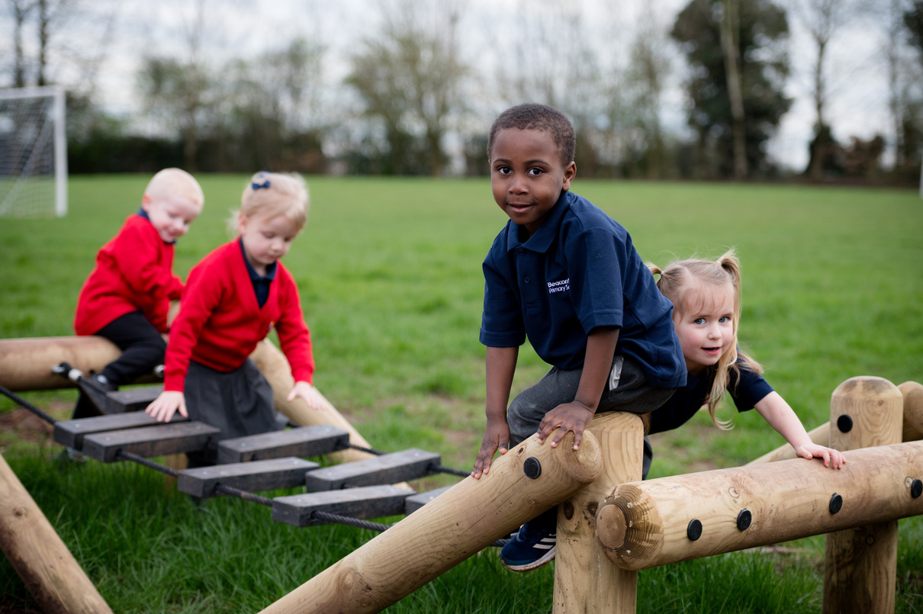

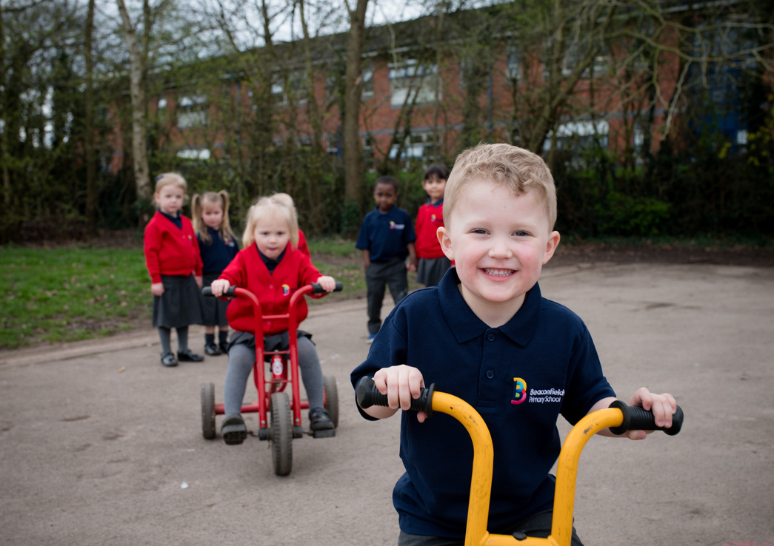

Contact Details
Beaconfields Primary School
Ramson Avenue
Stafford
Staffordshire
ST16 1ZY
Tel-01785 785699
office@beaconfields.academy

Slide 4
Welcome
Welcome to the Beaconfields Nursery! We are so excited to meet you and look forward to working collaboratively with you and your child. At Beaconfields, we believe in championing children and giving them a range of exciting opportunities to immerse them in their learning and to give them the best start for when they embark on their school journey.
We follow a progressive curriculum that considers children’s interests. We will be reading lots of stories, singing lots of Nursery Rhymes and songs. We have an Early Years Library where you can borrow books to take home to share with your child. We will be sending reading baskets and nursery rhyme baskets home for you to enjoy with your child and return back to us. Reading daily to young children helps with language acquisition and literacy skills. This is because reading to your children in the earliest months stimulates the part of the brain that allows them to understand the meaning of language and helps build key language, literacy and social skills.
We use a platform called Famly to keep you updated with your child’s progress. We will update it daily with what your child has eaten through the day and what times they have had their nappy changed and if they were soiled or wet. Every week we will upload photos of activities the children have been doing in Nursery and include information about how to support your child at home.

Slide 5
Welcome
In Nursery, we follow a program called ‘Squiggle While you Wiggle.’ This is a program designed for Nursery children. Squiggle While You Wiggle incorporates dance, music and large movements to help children develop the fine muscle control they need for writing. They will learn a new gross motor movement to a piece of music while holding 'Flipper Flappers' (bits of fabric) whilst dancing along to the music. They will then apply this new movement to a big sheet of paper using pens. At Nursery we follow the Little Wandle phonics scheme. This focuses on rhyming and initial sounds which lays the foundations for accessing phonics in Reception. In addition to this, throughout the day children will have access to the provision inside and outside allowing the children to choose where they play.
A typical day at Nursery will consist of:
Squiggle Whilst you Wiggle session
Key group time – various foci but usually maths
Phonics
Structured Story time/Talk for Write story telling session
Free Choice time in provision
Lots of singing and stories
The school has a web page Beaconfields Primary School – Home which has just been updated, where you will find lots of information including school newsletters, term dates and school events.
We also have a school Facebook and Instagram page that you can join too.
We look forward to working with you and seeing your child flourish…let the adventure begin! Please do not hesitate to contact us if you have any questions or concerns.
Mrs Harratt- Early Years Lead

Slide 6
What you will need
A named water bottle that your child brings daily. It is important you put your child’s name on as we have a lot of children having the same bottles.
A bag with spare clothes in, including socks please, as we sometimes get a bit messy or wet in the water tray. All named please.
Named wellington boots for our walks into the school forest.
Order a school lunch via Arbor or send your child with a nut free lunch.
Please ensure that the school know about any dietary requirements or allergies prior to your child starting with us.

Slide 7
Dinners and Snack
We have snack in Nursery at around 10:00am which is usually fruit, cereal or toast and at 2.30pm there will be a selection of fruit, crackers or breadsticks available.
Lunch time is at 12.00 and the children can have a choice of a school dinner or a packed lunch from home.
Packed lunches must be nut free as we are a nut free school. We also ask that foods such as grapes are sliced into smaller pieces.
School dinners can be booked through our school app called Arbor. For more information about how to access Arbor please contact the school office.

Slide 8
All About me
My name is… | My birthday is…
Who lives with me? | Other nurseries/ playgroups I have attended…
What makes me happy? | My favourite food is…. I can feed myself my lunch or My grown up helps me use a spoon
This is how my Parents/Carers think I will be feeling when I start in Little Explorers… | Two year health check Yes / No If yes date: Health Visitor: I have been to visit the Dentist Yes/No My Dental practice is called ….
Nappies / toilet trained Bottles Dummy / comforter | Who will collect my child on a regular basis: Password:
My child’s immunisations are all up to date Yes/No | Other important information (including medical, dietary and allergies)

Slide 9

School Uniform
At Beaconfields nursery we wear a uniform.
Navy polo shirt with Beaconfields logo
Red or cardigan with Beaconfields logo
Grey skirt, pinafore, grey leggings, grey trousers/Joggers
Grey or white socks
Black shoes
Long hair must be tied up with yellow or blue hair accessories.
Coat with a hood
Puddle suit if your child has one as we go out in all weathers and
jumping in puddles is one of our favourite activities.
Uniform can be purchased
from:
https://crestedschoolwear.co.uk or crested wear school shop in the town

Slide 10
Permissions
I am happy for my child to taste different foods and drink at nursery. Sign …………………………………………………………… Date……………………………………………….
I am happy for my child to go on a walk around the local area and visit the park. Sign …………………………………………………………… Date ……………………………………………
I am happy for staff to apply sun cream to my child if Requested by parents. Sign ………………………………………………………… Date………………………………………………….
I give permission for school to share information with my child’s Health Visitor if needed. Sign……………………………………………………………. Date……………………………………………….

