Slide 1







WelcomeTo
Base
@
Beaconfields Primary School
Be More Beaconfields

Slide 2





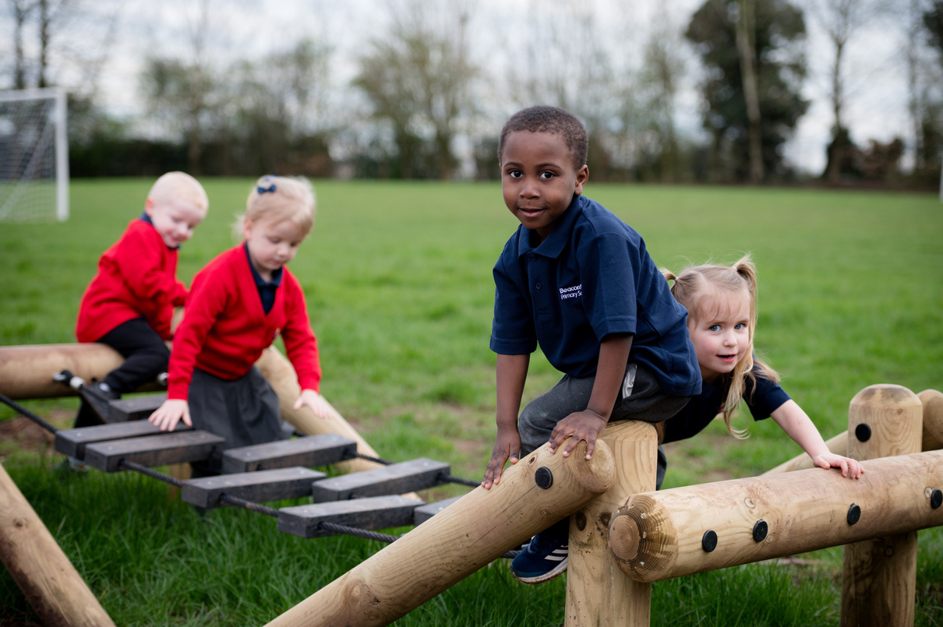
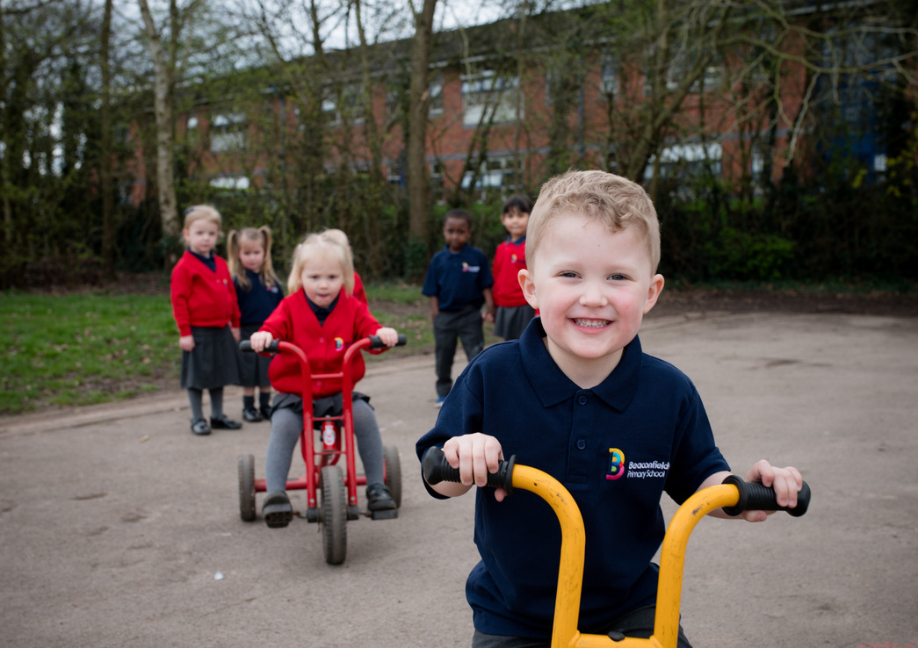

Welcome to Base
Beaconfields Primary School provides before and after school care in a welcoming and caring environment.
Base provides a safe and supportive environment for the children who attend. The children are nurtured by familiar adults and are encouraged to participate in a range of exciting and interesting activities indoors and outdoors. Each week Base is led by a theme which the weekly activities are hooked onto. Interaction, books and hands-on activities encourage Beaconfields children to explore a variety of subjects alongside cosy reading areas. Base is a before and after-school hub where imagination thrives and learning knows no bounds. Children may also use their time in Base to complete any homework tasks, reading and spelling.
Children and staff value one another and work together to create a Base where children can play, have fun and build on their learning.

Slide 3
We will...
  Provide accessible and affordable childcare for Beaconfields Primary School children.
  Encourage self-esteem, self-awareness and self-confidence.
  Encourage children to initially make friends and then socialise with each other as they grow older.
  Encourage older children to interact with the younger children modelling good behaviour and learning strategies.
  Encourage children to communicate effectively with each other and adults.
  Provide a variety of activities to cater for all ages including a homework area where the children can complete this with the opportunity to use technology when the need arises.
  Encourage respect for and to everyone.
  Celebrate the children’s achievements and successes from each day.

Slide 4
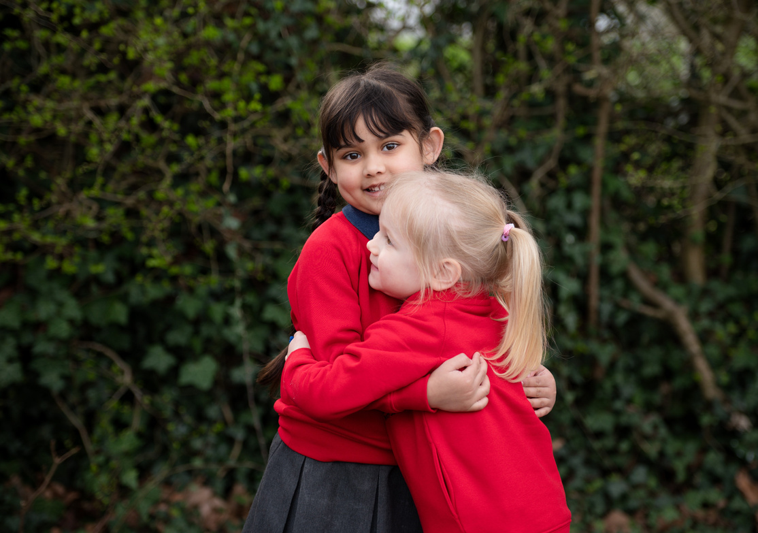


Times & Prices
Before School
Times: 7:30am - 8:50am
Price: £6.00 per session
Base is open from 7:30am and serves a breakfast of toast, cereal, orange juice, water or milk. Children have the opportunity to access breakfast throughout the duration of the morning session. In addition, there is a wide variety of activities that the children can choose from. At 8:50am, a member of staff will accompany the children to their classrooms ready for the day ahead.

Slide 5
Times & Prices
After School
Prices: £3.60 per session from 4:15pm - 5:00pm
£7.20 per session from 3:30pm - 5:00pm
£9.60 per session from 3:30pm - 5:30pm
£12.00 per session from 3:30pm - 6:00pm
After school club starts as soon as school has finished. The children are collected from their classrooms by a member of staff who will have a register of the children who will be attending. Once the children are in Base, they will be provided with a healthy snack such as crackers, breadsticks, fruit or yogurt.
If your child attends a school run club after school hours then Base will take over their care from 4:15pm onwards.
Late collections after 6pm will incur a £15 charge per 15 minutes.
Childcare vouchers are accepted.
Payment may be made via Arbor only, a log in will be set up for you. Beaconfields Primary School is a cashless school.

Slide 6

Breakfast Menu

Slide 7

Snack Menu
Tea time boxes can be booked a week in advance for after school at a cost of £2.50. This includes a ham or cheese sandwich, crisps, fruit, cake bar. A drink of juice or water is provided.

Slide 8
Missed Sessions
If your child cannot attend Base, cancellations need to be given at least 24 hours in advance or you will be charged for the missed session. However, if your child becomes hospitalised we will refund you for any missed sessions during their hospital stay.
At Base we ask that:
You will pay one month in advance via Arbor for the sessions your child will attend.
You will be charged for every session you have booked on Arbor unless you have requested to cancel your session through the office. Unfortunately, the office staff will need to cancel any unwanted sessions.
We do not charge if your child has been admitted to hospital.
You will be given one week’s notice if it is necessary for us to withdraw your child’s place for non-payment of fees.

